Slide 1

Power Consumption of Tetouan City: A Comparison of Linear Regression and Linear SVC Models
Yashwanth Reddy Boddireddy | 31612593 | DS644

Slide 2

Project details
Models to be compared: Linear regression and Linear SVC
Model parameters that were varied: C regularization, Learning Rate.
Dataset: https://archive.ics.uci.edu/static/public/849/power+consumption+of+tetouan+city.zip
Dataset source: Power consumption of Tetouan city - UCI Machine Learning Repository
Dataset type: Tabular Data with 52416 rows and 9 columns.
Data Columns: DateTime, Temperature, Humidity, Wind Speed, general diffuse flows, diffuse flows, Zone 1 Power Consumption, Zone 2 Power Consumption, Zone 3 Power Consumption
Accuracy metric: Accuracy
Cross validation: 5-fold

Slide 3
Data preprocessing
There are no missing values and nan values in the dataset.
Did setting index to DateTime for better visualization
Renamed some columns
Produced some columns
Extracted dates and time from DateTime into separate columns.

Slide 4
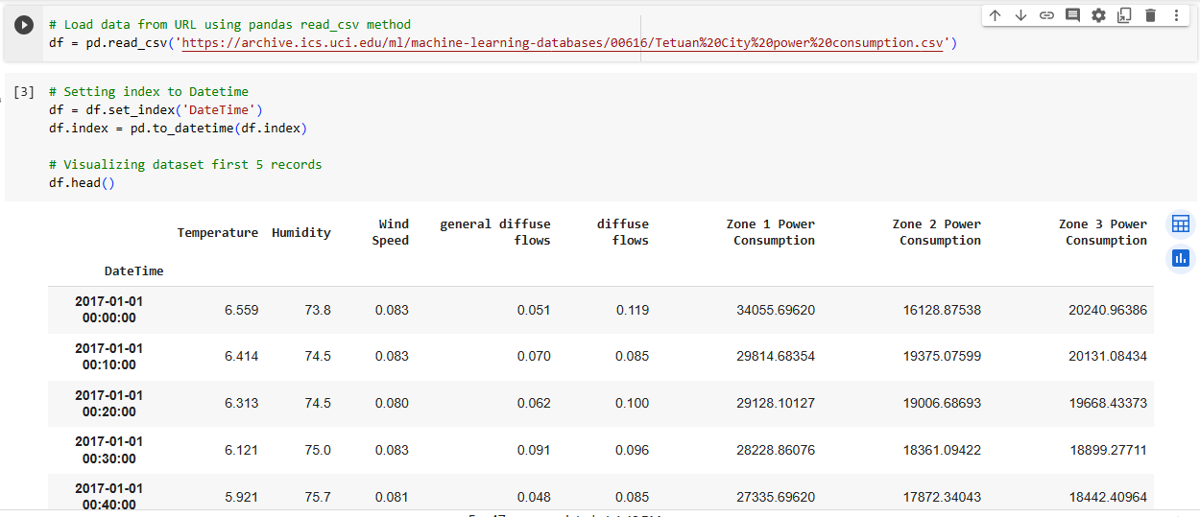
Code and Results:

Slide 5
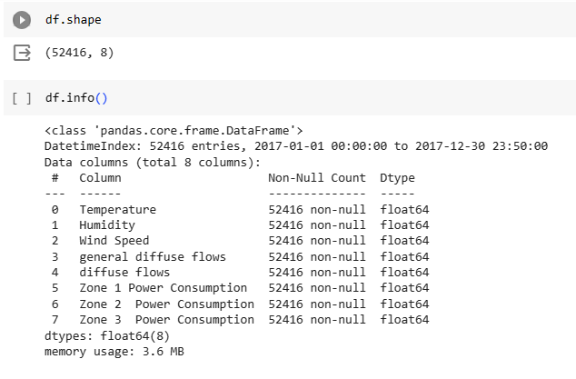
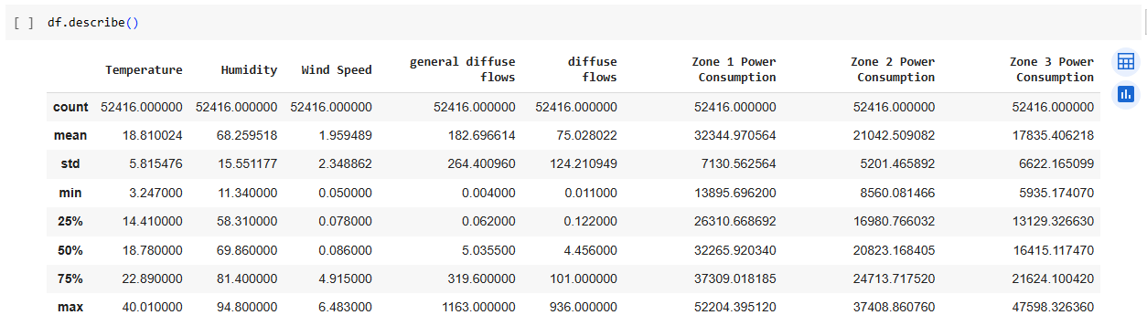

Slide 6
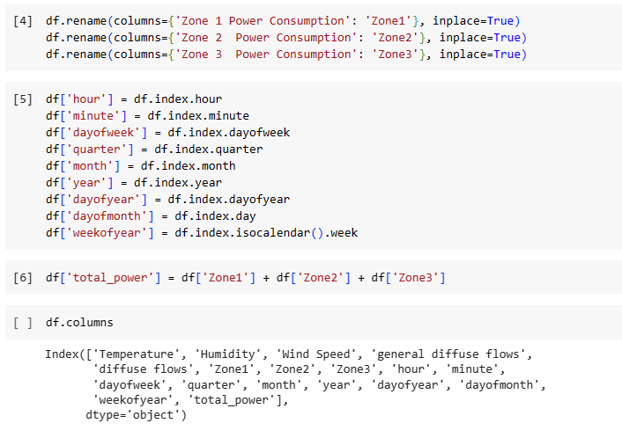
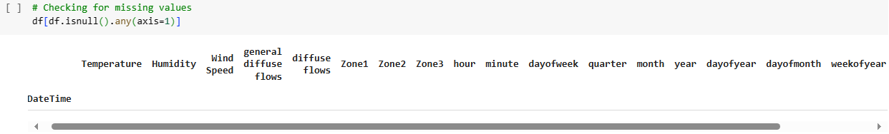

Slide 7
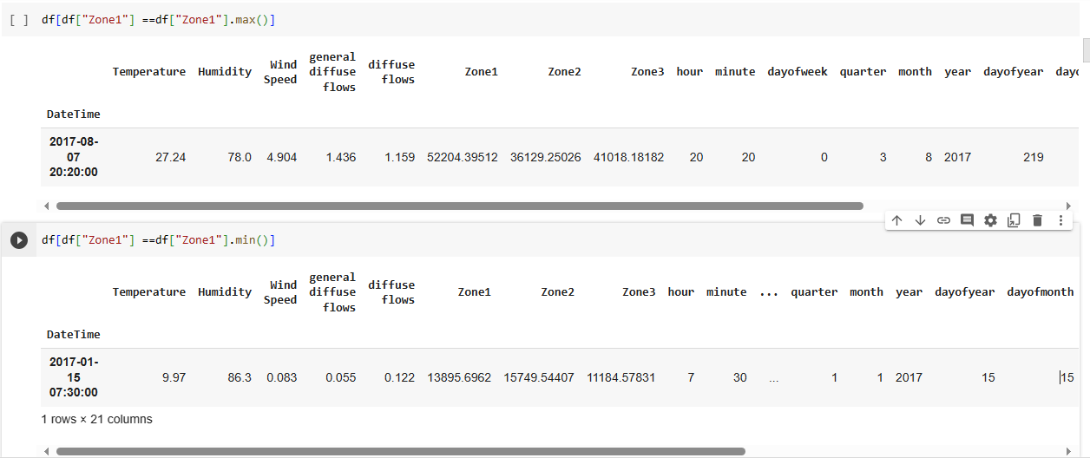

Slide 8
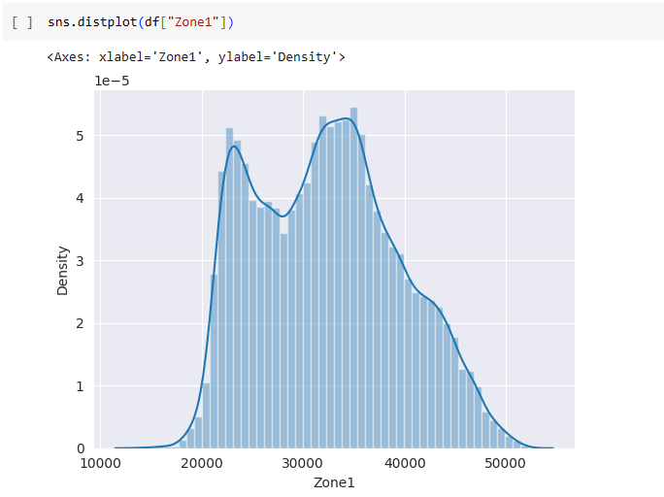
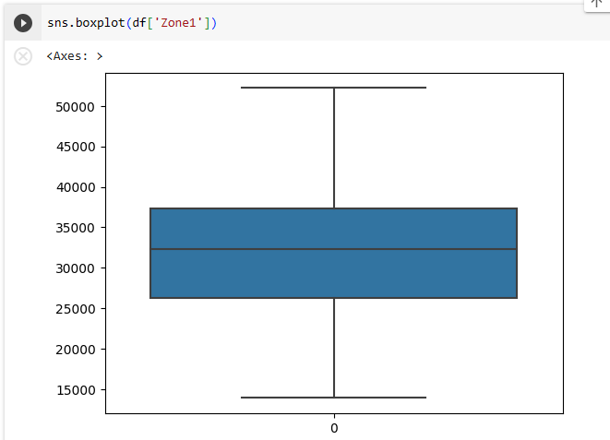

Slide 9
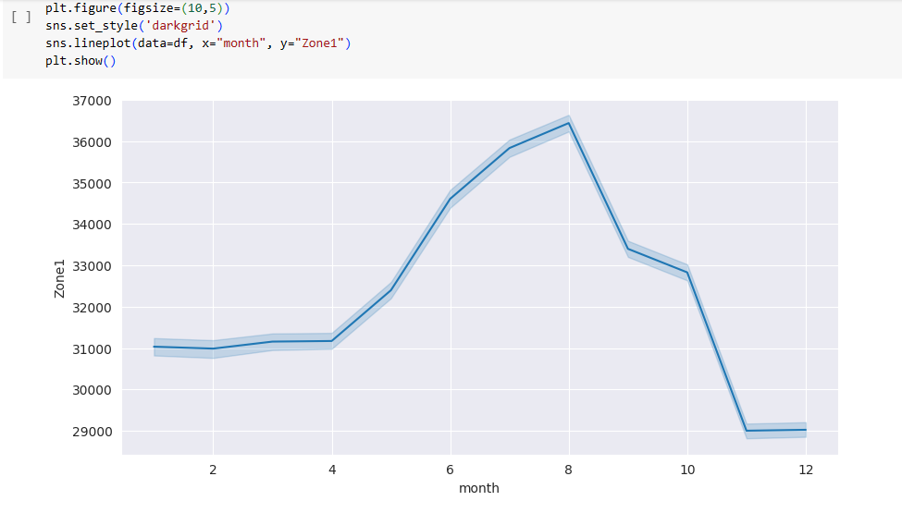

Slide 10
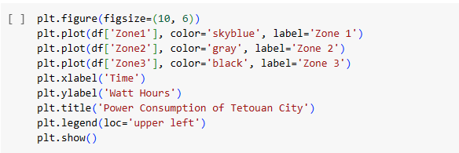
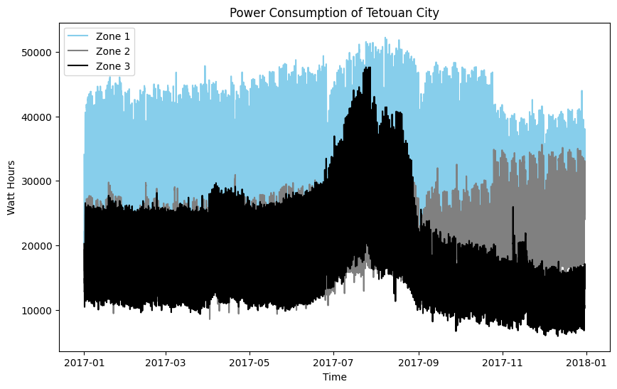

Slide 11
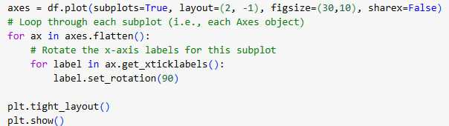
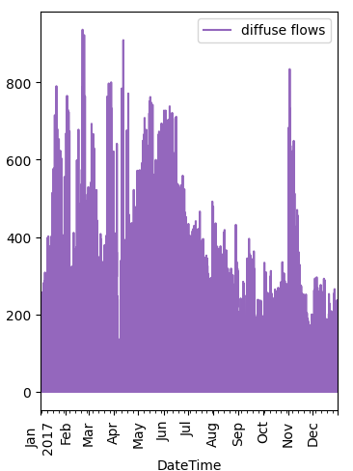
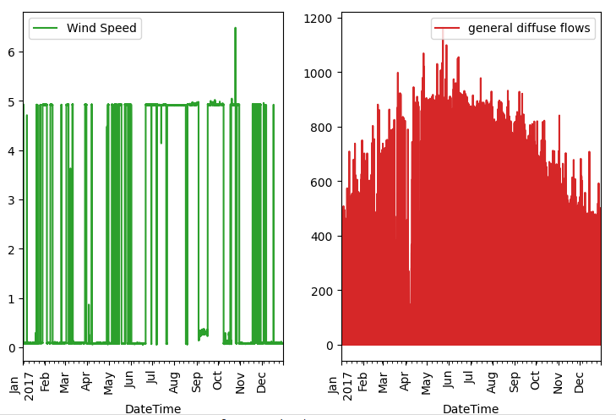
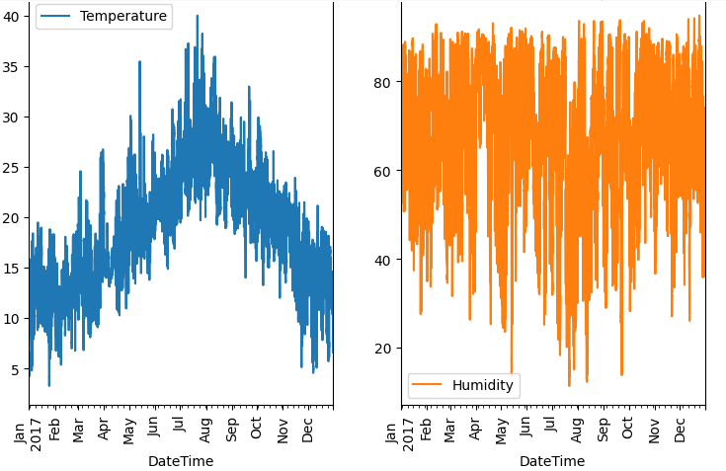

Slide 12
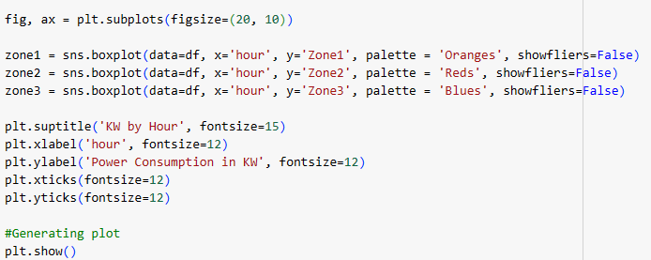
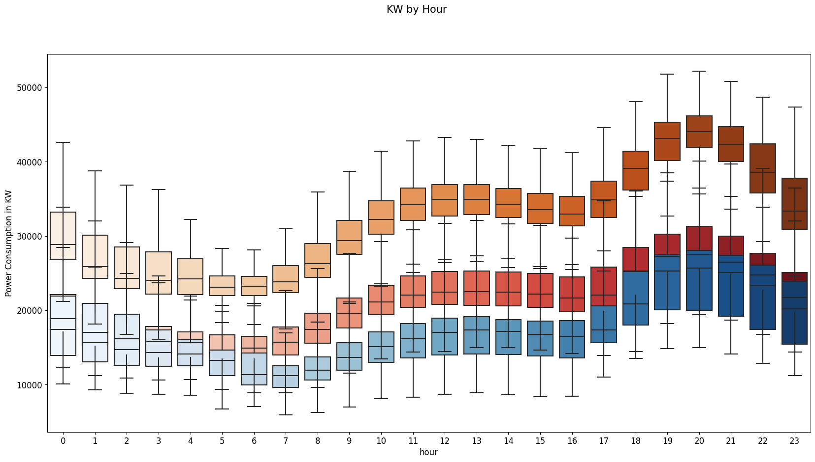

Slide 13
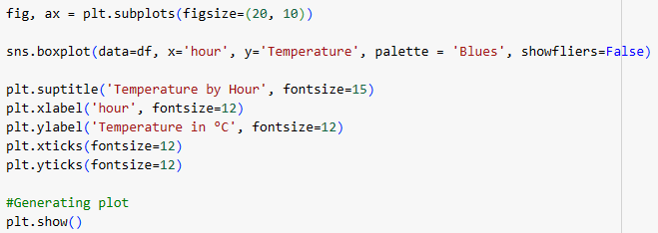
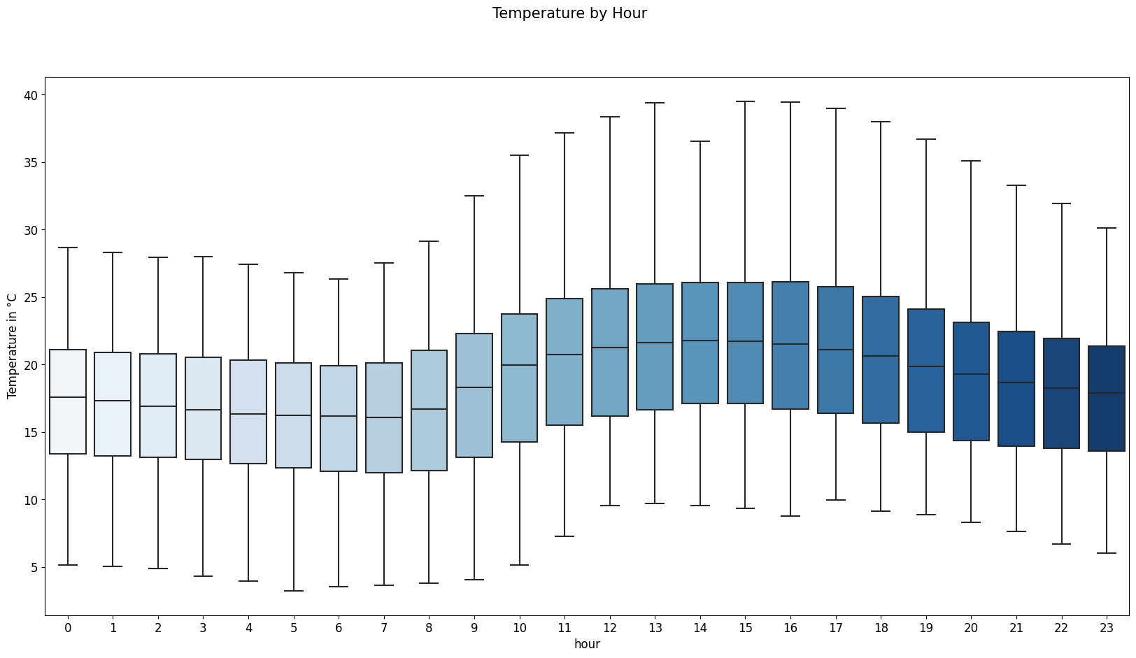

Slide 14
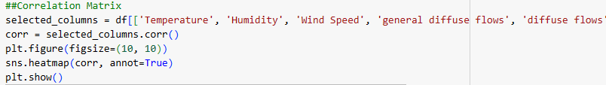
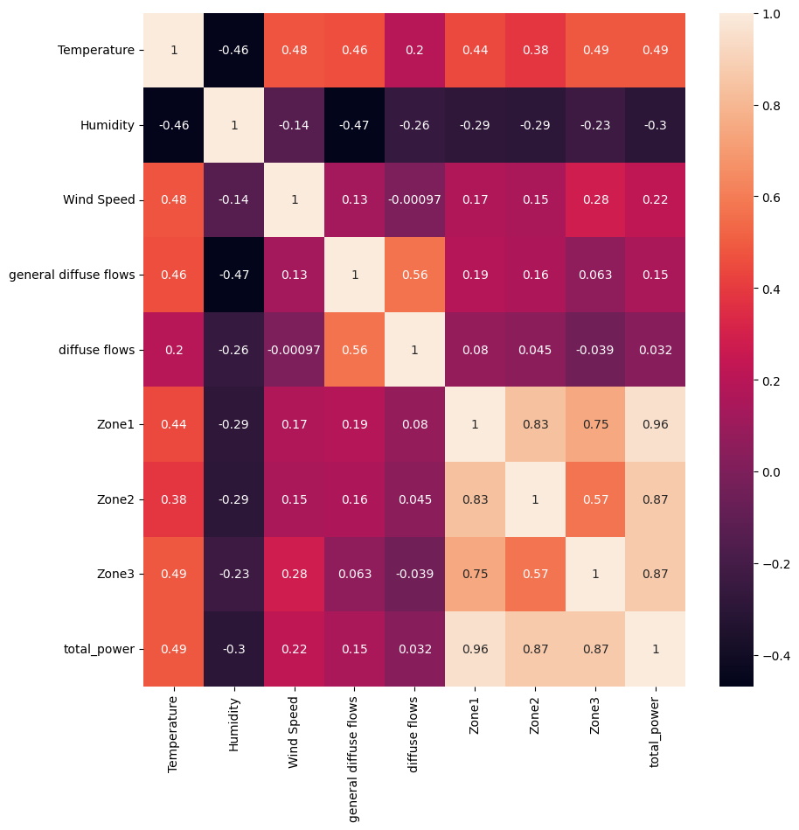

Slide 15
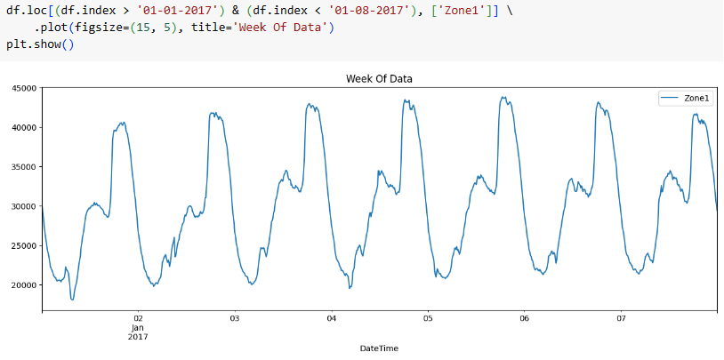
Zone1 power consumption for 1st Week of Jan 2017

Slide 16
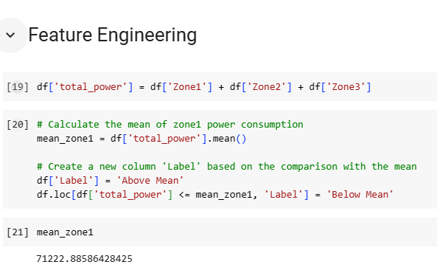

Slide 17
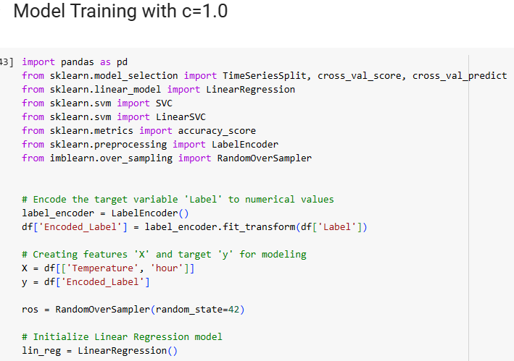
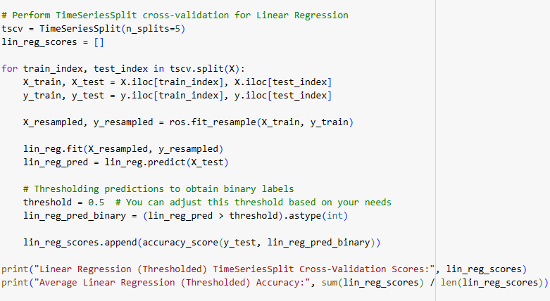

Slide 18
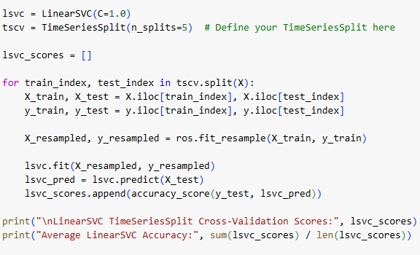

Slide 19
Linear SVC | C=0.1 | C=1.0 | C=10 | C=20
Accuracy | 0.803 | 0.767 | 0.761 | 0.762
Linear Regression | Learning Rate=0.001 | Learning Rate=0.01 | Learning Rate=0.01 | Learning Rate=0.1
Accuracy | 0.806 | 0.720 | 0.409 | 0.480

Slide 20
Conclusion:
From all the model trainings with different parameters we can say that Linear Regression performed well than Linear SVC.
Find my code here :https://github.com/yashwanthreddy7178/bigdataproject

Slide 21
Next Steps:
Integrating external data for Beter analysis.
Implementing with different machine learning models.
Apply the same study to different cities or a distribution network.
Financial study to measure the economic impact to configure power supply based on forecasts.
Real time model performance and improvement

Slide 22
References:
Salam, A., & El Hibaoui, A. (2018, December). Comparison of Machine Learning Algorithms for the Power Consumption Prediction:-Case Study of Tetouan city–. In 2018 6th International Renewable and Sustainable Energy Conference (IRSEC) (pp. 1–5). IEEE.
robikscube. (2022, July 5). Time Series Forecasting with Machine Learning [YT]. Retrieved September 29, 2022, from Kaggle.com website: https://www.kaggle.com/code/robikscube/time-series-forecasting-with-machine-learning-yt

Slide 23

Thank You
Q&A

